Slide 1
Assistantship Hiring Process
2024-2025

Slide 2
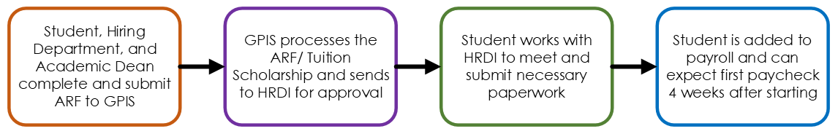
Hiring Timeline
Processing Deadlines for Fall or All-Year TAGA Hires
Hiring Departments have more flexibility when hiring students for the fall or entire year
School: June 15
Reviews & approves ARF
Uploads it to the TAGA Team Site
Processing Deadlines for Spring TAGA Hires
Spring hiring deadlines are unforgiving due to time constraints between the fall and spring terms
School: November 15
Reviews & approves ARF
Uploads it to the TAGA Team Site

Slide 3
Graduate or Teaching Assistantship
Appointment Request Form (ARF)
Students are hired through the submission of an approved Appointment Request Form (ARF) to the Office of Graduate, Professional & Interdisciplinary Studies
Students fill out the first page of the ARF, Hiring Departments fill out the second page and approve the ARF, which is then sent to GPIS.
GPIS will process and receive the Fair Chance Form from the student.
The ARF and Fair Chance Form will be sent to HRDI.
HRDI will finalize necessary paperwork with the student.
Student will be added to Payroll.

Slide 4
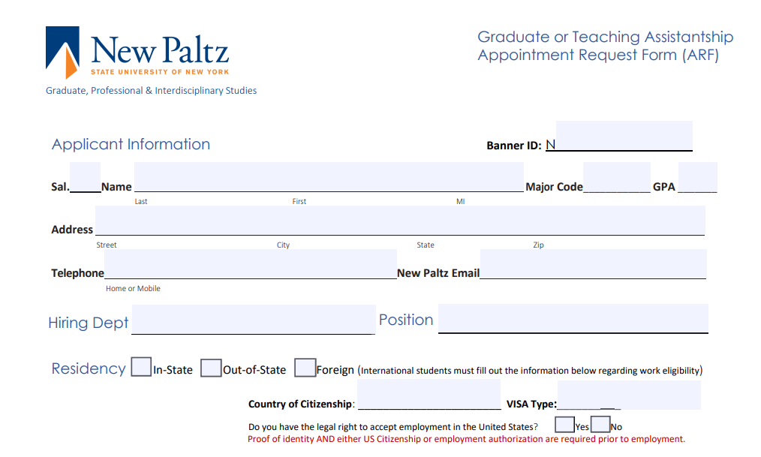
Student Fills out Page 1
Students fill out their information on the top half of the ARF:
Banner ID, Name, Major Code, GPA, Address, Phone, Email, Hiring Department, Position, and Residency Info

Slide 5
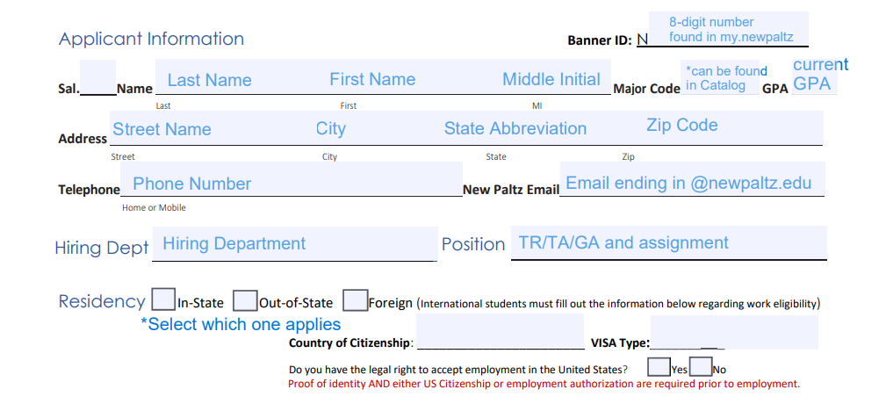
Template

Slide 6
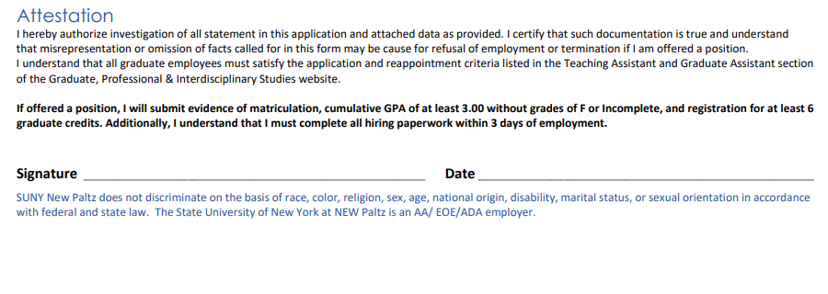
Student Fills out Page 1
Students sign and date the bottom of the first page of the ARF agreeing to the terms of acceptance of the position.

Slide 7
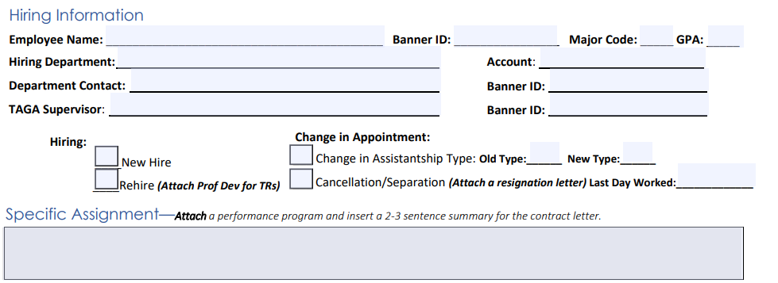
2. Hiring Dept Fills out Page 2
The Hiring Department will fill out the Hiring Information: employee information, department information, whether the student is new or returning, indicate if a change is being made, and provide 2-3 sentences describing the position.

Slide 8
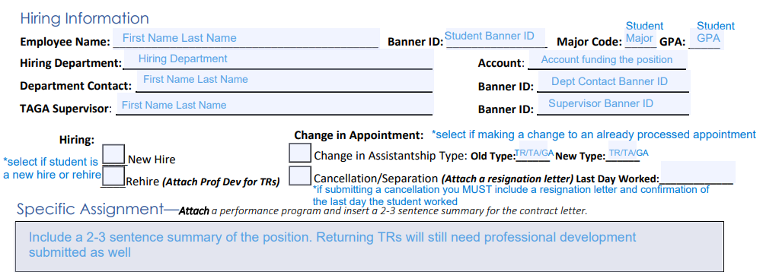
Template

Slide 9
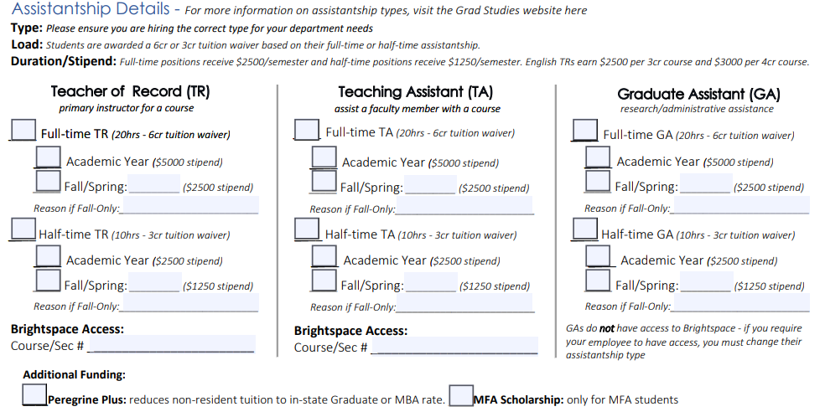
2. Hiring Dept Fills out Page 2
The Hiring Department will fill out the information regarding the assistantship - including type, load, duration, Brightspace access, and any additional funding

Slide 10
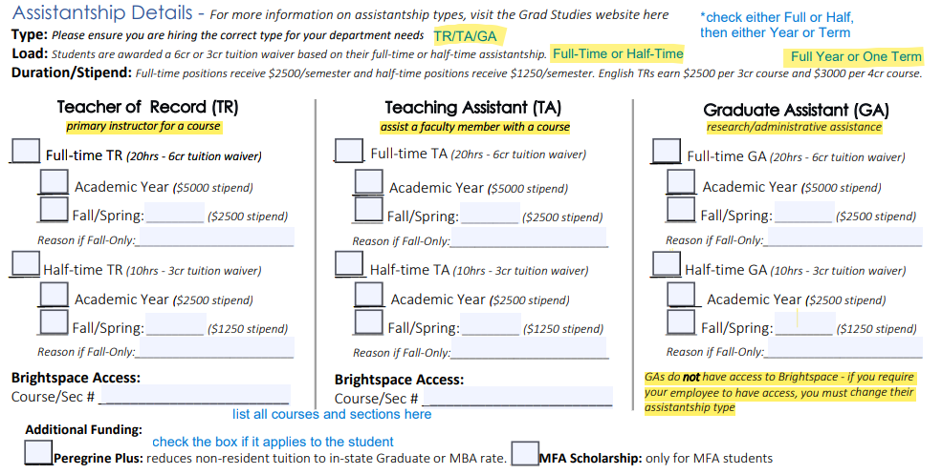
Template

Slide 11
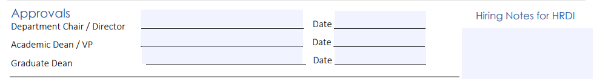
3. ARF receives approvals and is sent to GPIS
The Department Chair and Academic Dean must both sign and date the ARF before it is submitted to Graduate Studies.

Slide 12
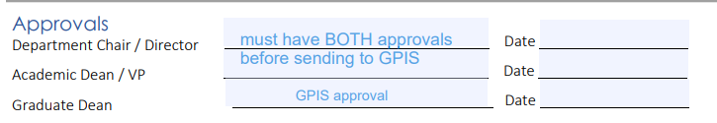
Template

Slide 13
4. GPIS Processes ARF/Tuition Waiver
GPIS will fill out the appropriate tuition rate (in or out of state, MBA rate), number of credits the waiver will go towards, the yearly stipend information, and the account from which the position is being funded.

Slide 14
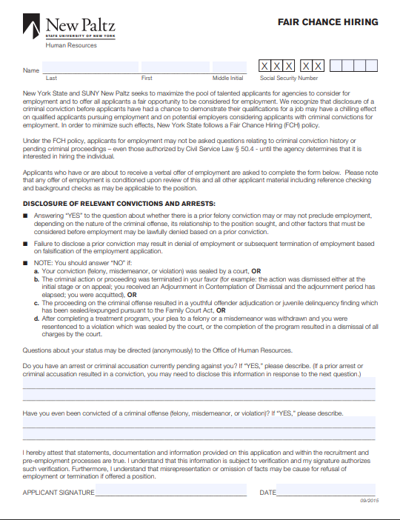
5. GPIS receives Fair Chance Form from Student
Students can find the Fair Chance Form on the Graduate Studies Website.
Students submit their completed form to the Office of Graduate, Professional & Interdisciplinary Studies for further processing

Slide 15
6. GPIS/HRDI/Payroll
GPIS will send both the ARF and Fair Chance Form to HRDI
HRDI will send out an Appointment Letter and email with login information for PeopleAdmin where Students upload hiring paperwork
(Orientation/International/Meetings)
Student is added to Payroll and can expect first check four weeks after their start date

Slide 16
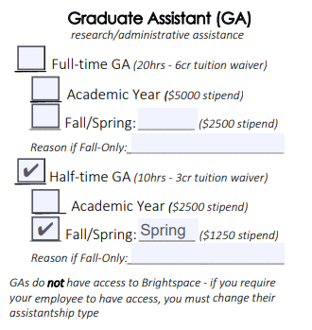
Examples
A student being hired as a GA for a half-time, Spring appointment

Slide 17
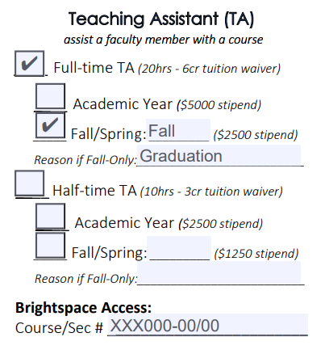
Examples
A student being hired as a TA for a full-time, Fall appointment with indicated Brightspace access to two sections of a course

Slide 18
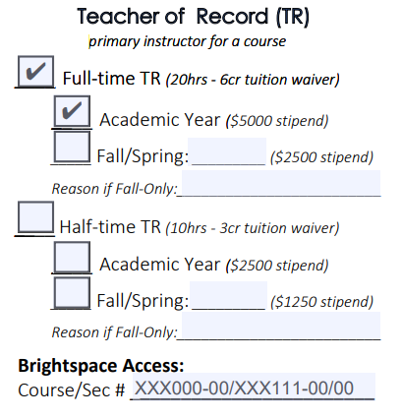
Examples
A student being hired as a TR for a full-time, all year appointment with indicated Brightspace access to two courses

Slide 19
Additional Information
Refer to the Graduate Studies website for further information regarding assistantship types, the hiring timeline, and helpful contacts about the process
Click here to view the template ARF

